Slide 1

Registration Portal Final Software Project
Kendric Garmon
The University of Arizona Global Campus
CST 499 Capstone for
Computer Software Technology
Professor Amr Elchouemi
May 16, 2023

Slide 2
Software Requirements Specifications (SRS)
System Requirements
1. New User Registration
- Account and Profile Creation
- Unique ID and Password
- Guard against duplicate IDs
2. User Profiles
- Key Information: Name, Phone, Email, and more
- Comprehensive applicant details
3. User Login
- Access using registered ID and Password
- Secure and convenient login process
4. Online Courses and Semesters
- Three Semesters: Spring, Summer, and Fall
- Course Offerings vary by Semester
5. Course Enrollment
- Maximum Enrollment for each Course
- Waiting List for Full Courses
6. Course Enrollment Management
- User's ability to Cancel Enrollment
- System notifies first user on Waiting List
Key Elements Include:
Purpose: The purpose of the registration portal is to provide an online platform for students to register for courses, manage their course schedule, and access academic resources.
User Roles: The system supports students can register for courses, view their enrolled courses, add or drop courses, and access course materials.
Registration and Login: The portal allows students to create new accounts and log in using their credentials. User authentication and secure password storage are implemented to ensure data privacy and security.
Course Management: Students can search and view available courses, including their course details, such as course code, instructor, start and end dates, and capacity. They can register for courses, drop courses, and view their registered courses.
Course Enrollment: The portal enforces course capacity limits, ensuring that students cannot exceed the maximum number of enrollments for a course. A waitlist feature is included to handle cases when a course reaches its capacity.
User Interface: The portal provides a user-friendly interface with intuitive navigation, clear information presentation, and responsive design to ensure a seamless user experience across different devices.
Security and Privacy: The system implements security measures to protect user data, including secure login, data encryption, and access control
Notes:
A Software Requirements Specification or SRS document, is a document that outlines the detailed requirements for a software project. The primary purpose of an SRS is to capture and document the functional and non-functional requirements of the software. In the SRS document for this registration portal, we define the following:
Purpose: Online platform for students to register for courses, manage their schedule, and access resources.
User Roles: Students can register, view enrolled courses, add/drop courses, and access materials.
User Interface: User-friendly design, intuitive navigation, responsive.
Security and Privacy: Secure login, data encryption, access control.
Requirements:
Registration and Login: Provide secure user authentication and password storage.
Course Management: The ability to search courses, view details, register, drop, and view registered courses.
Course Enrollment: Enforce course capacity limits and provide a waitlist feature.

Slide 3
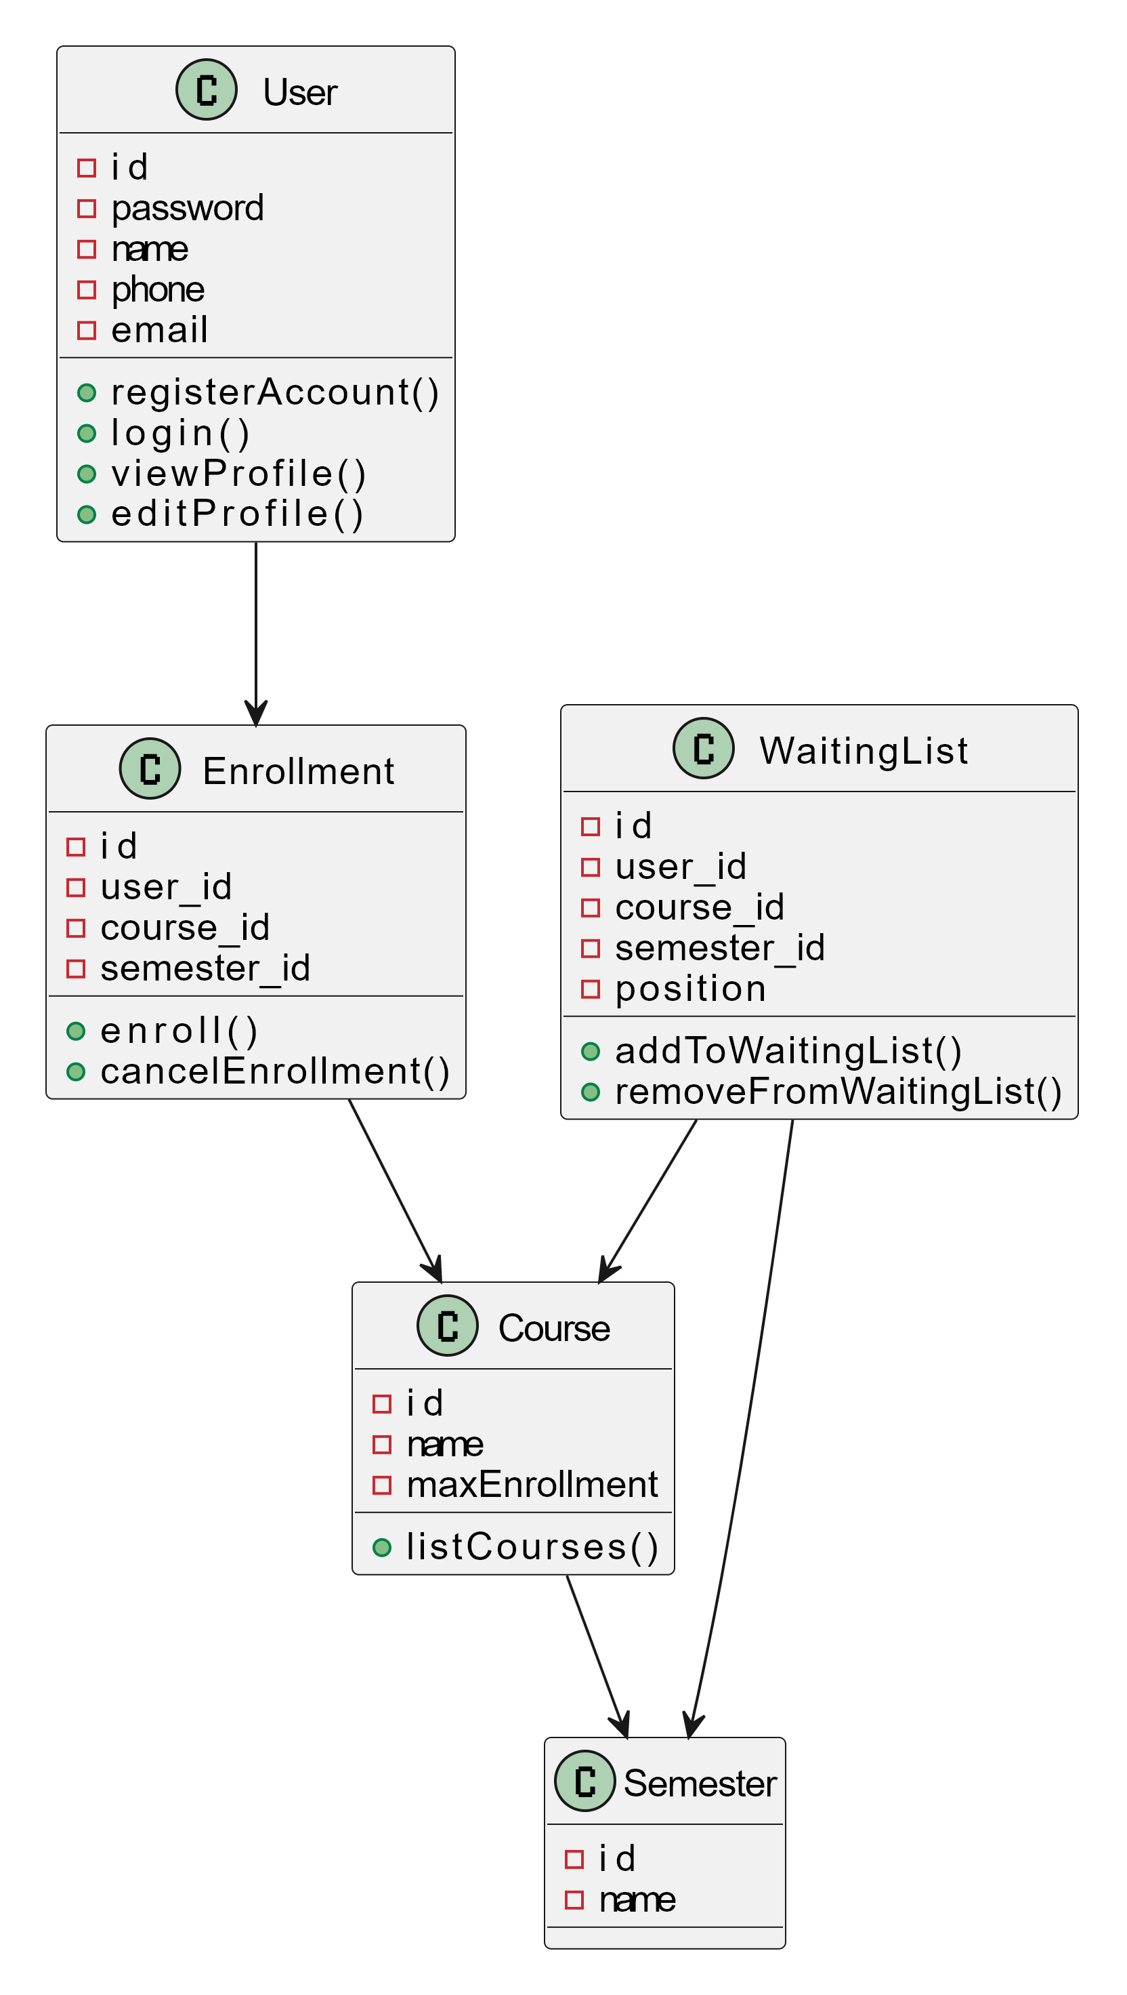
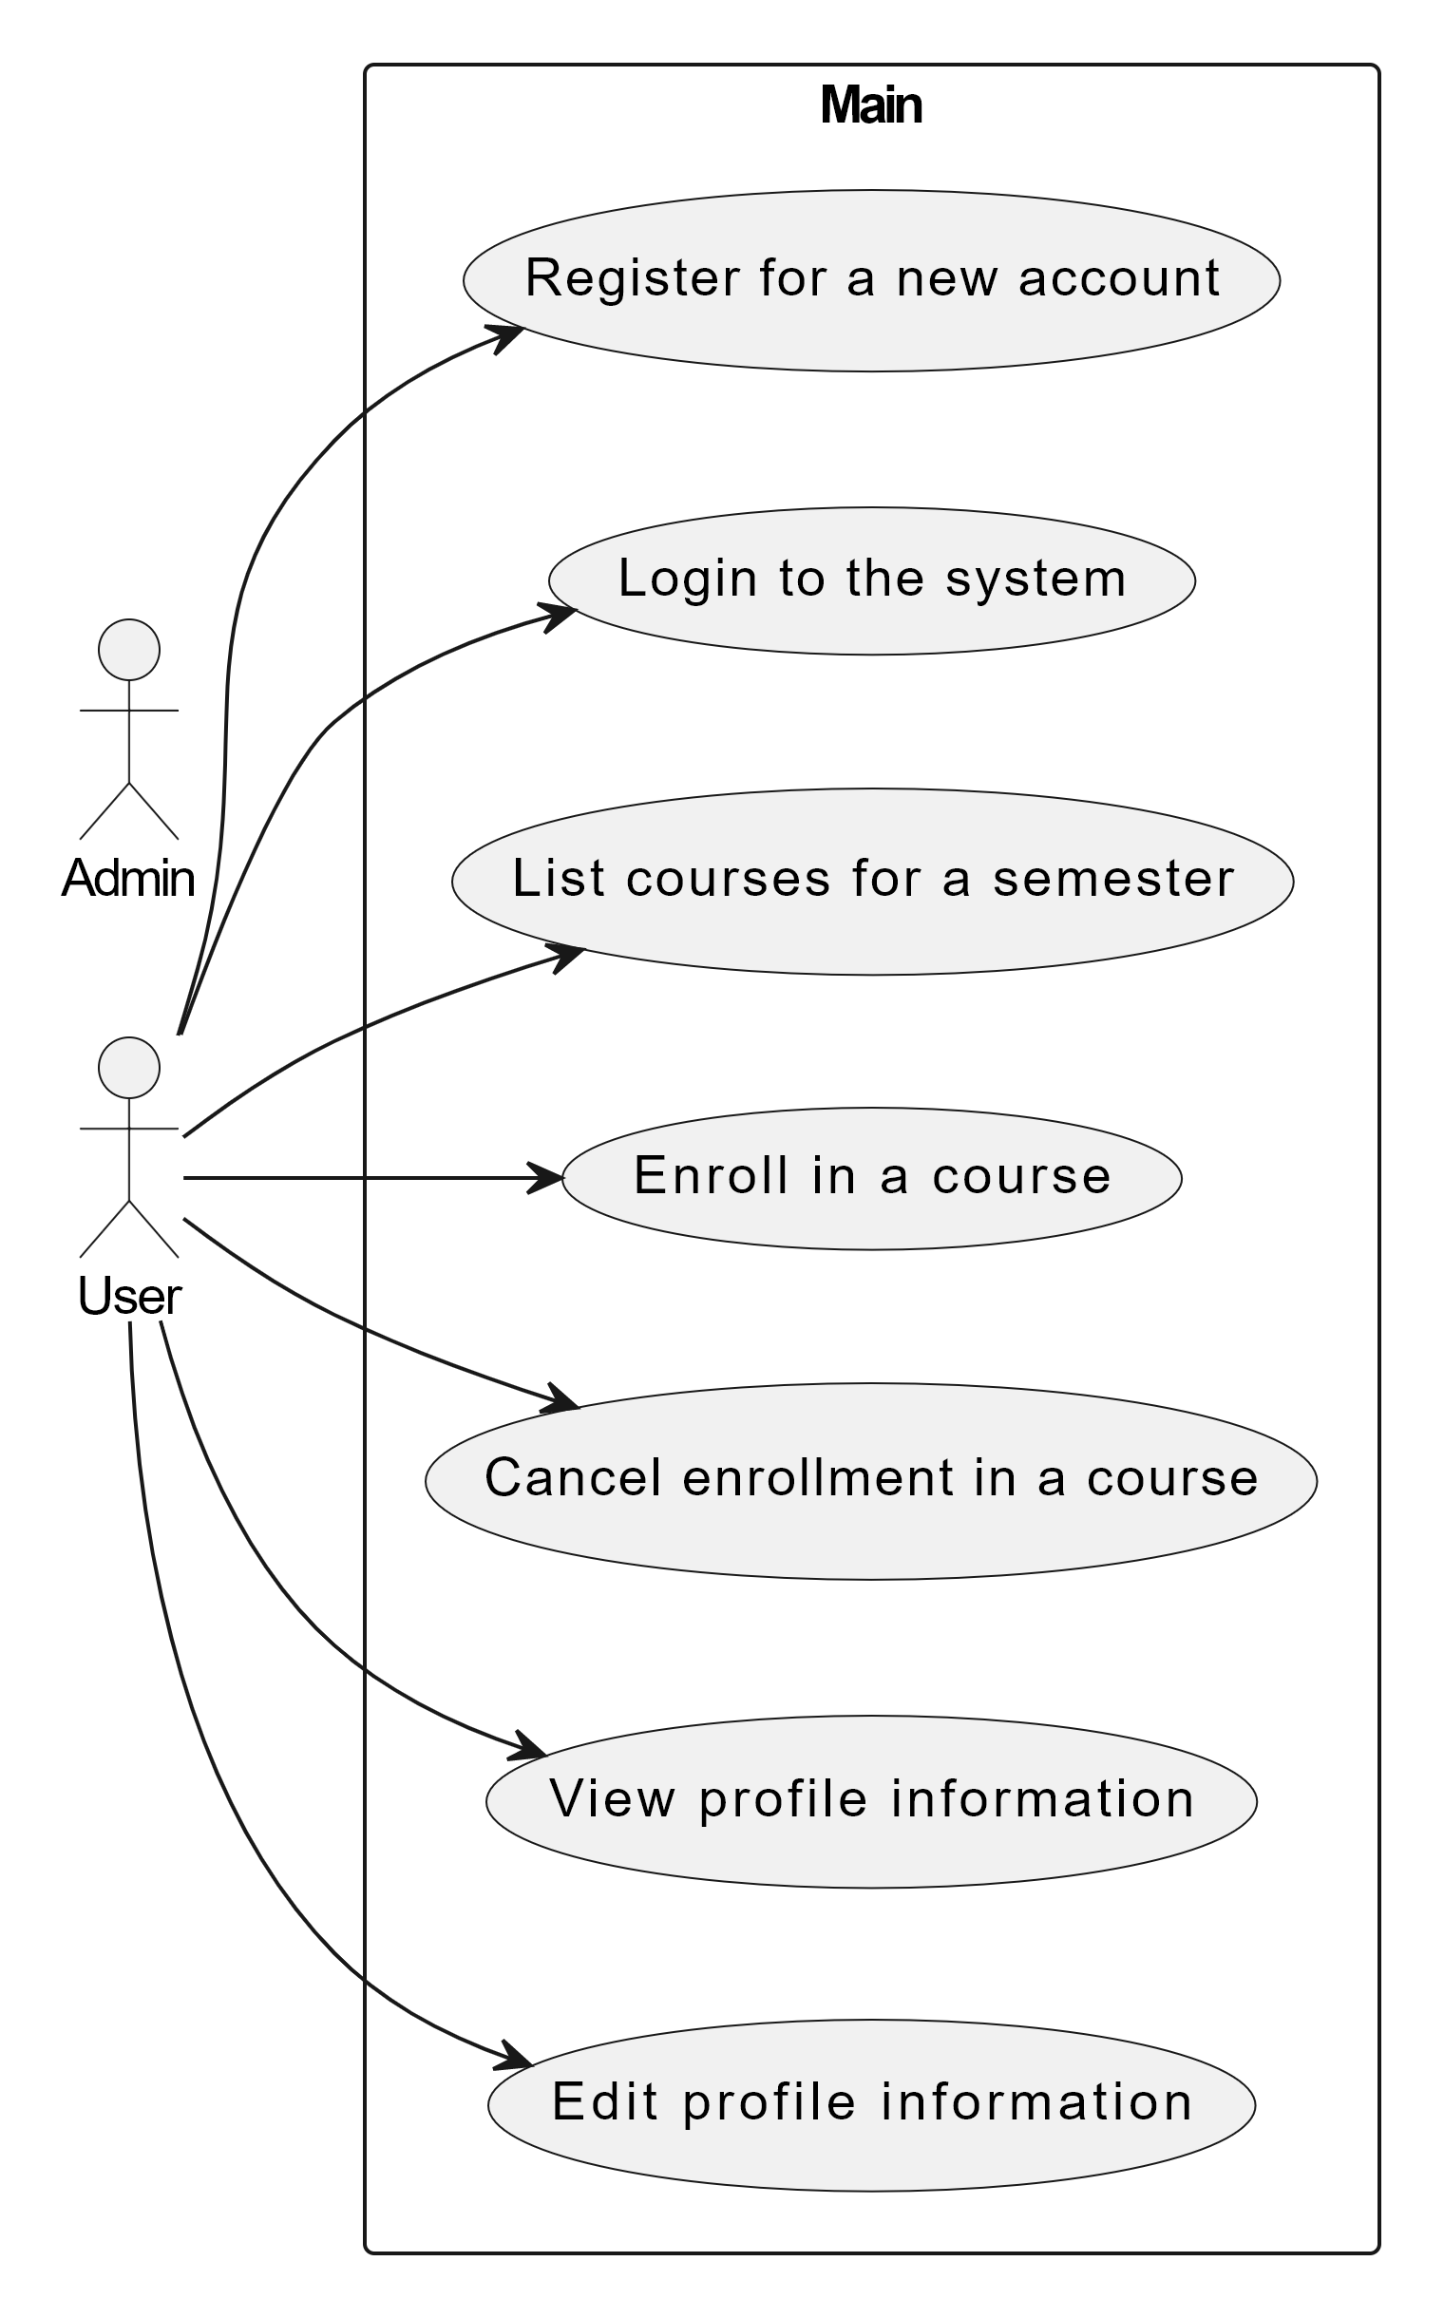
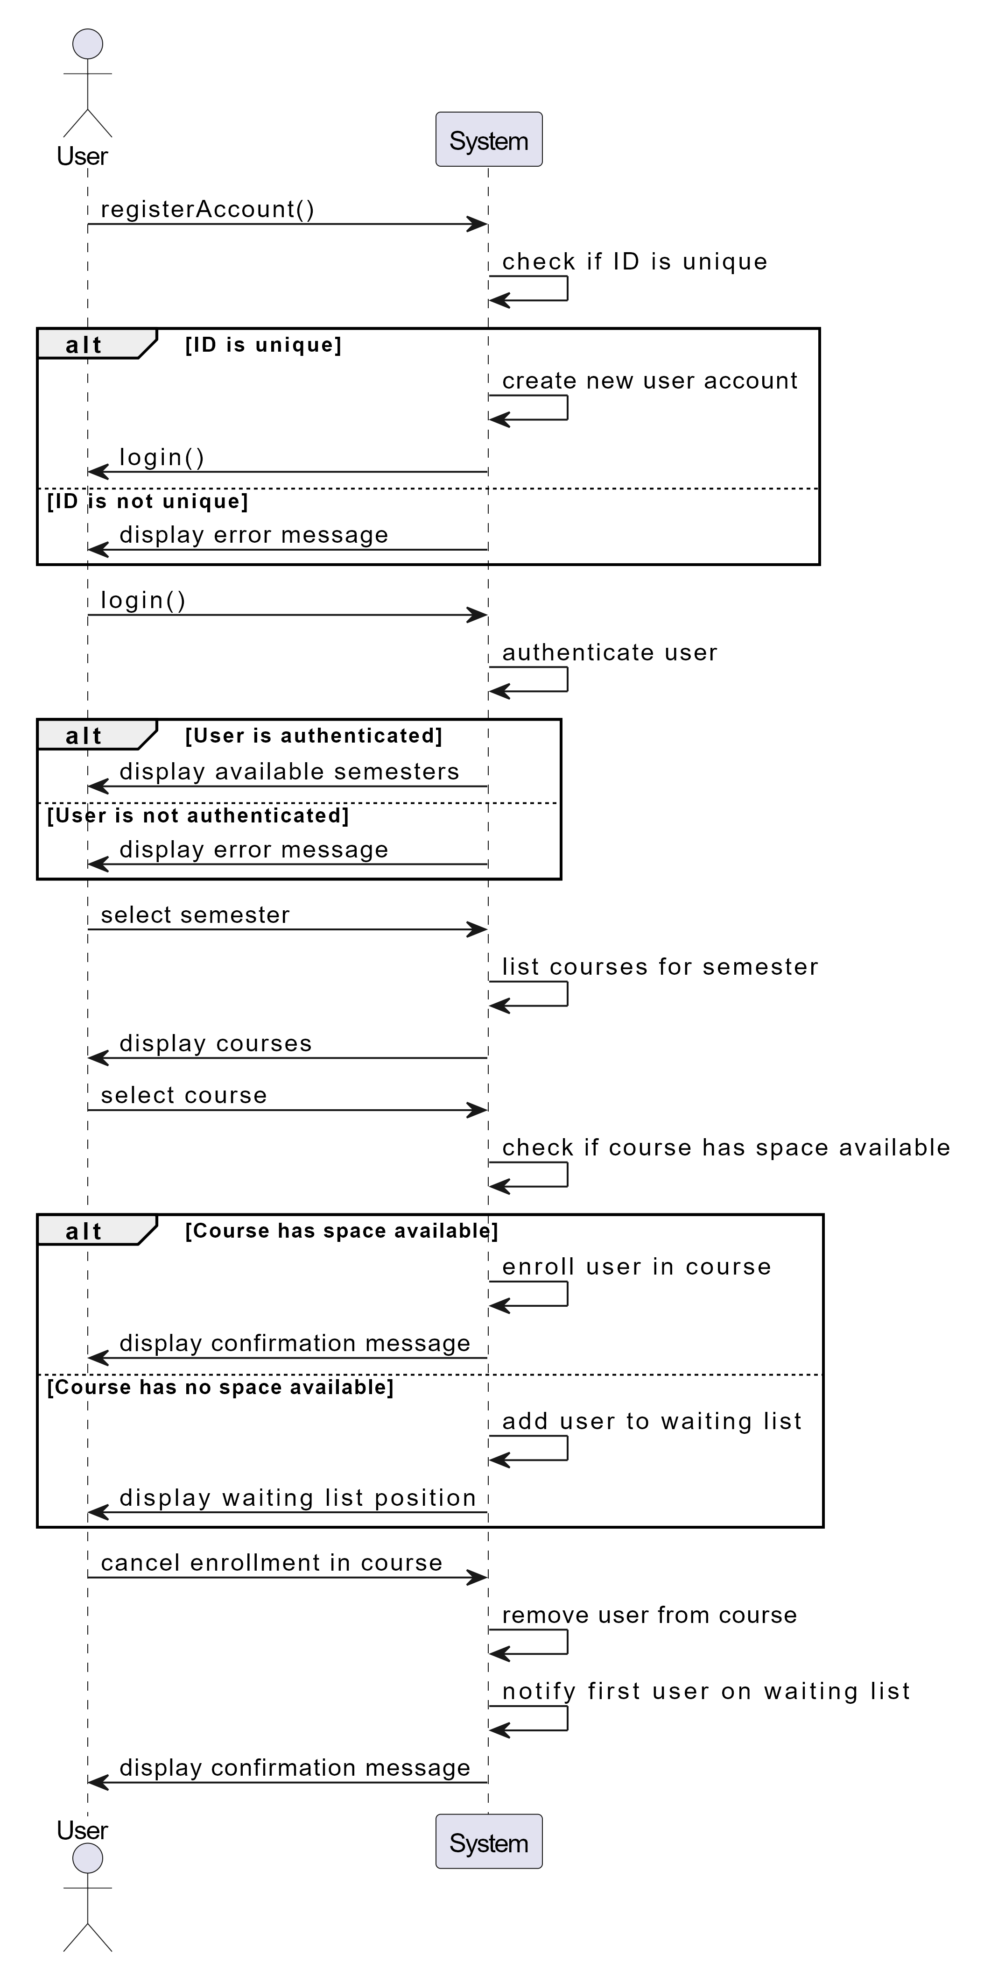
UML Design Models
Class Diagram
Use Case Diagram
Sequence Diagram
Notes:
Use Case Diagram : This diagram illustrates the interactions between the User and the system. The User can perform various actions such as registering for a new account, logging into the system, listing courses for a semester, enrolling in a course, canceling enrollment in a course, and viewing/editing profile information.
Class Diagram: This diagram represents the class structure and relationships in the system. It includes classes for User, Course, Semester, Enrollment, and WaitingList. The relationships between the classes are depicted with arrows. Users can have enrollments, enrollments are associated with courses, courses are associated with semesters, and waiting lists are associated with courses and semesters.
Sequence Diagram: This diagram represents the interaction between the User and the System in various scenarios. It outlines the sequence of actions and decisions that take place during account registration, login, course selection, enrollment, cancellation, and waiting list management. This diagram also provides a visual representation of the user-system interactions and the decision points involved in the registration, enrollment, and waiting list processes.

Slide 4
Design of Registration Portal Pages
Login Page
The login page is where users authenticate themselves to access their account and perform actions.
The design is clean and focused on the login form.
Landing Page
The landing page serves as the entry point to the registration portal, providing an overview of its purpose and benefits.
A prominent call-to-action “Get Started’ encourages users to navigate into the portal.
The layout is structured for easy navigation and clear information hierarchy.
Portal Page
The portal page allows users to view, add and remove courses.
If spots are limited, remaining spots or a waitlist option is indicated.
Courses Page
The courses page allow uses to view available courses and all of the information about them
It also provides a link to the portal page.
The courses information is depicted on a card and each set is grouped by the semester the course belongs to.
Notes:
There are four main pages in this portal, the login, landing, portal and courses pages. The general design of these pages are responsive, adapting to different screen sizes and devices.
Bootstrap is a popular open-source front-end framework that simplifies and accelerates the process of building responsive and mobile-first websites and web applications.
Bootstrap’s responsive grid system, classes, and utilities provide a means for a well organized and user-friendly experience throughout the portal pages.

Slide 5
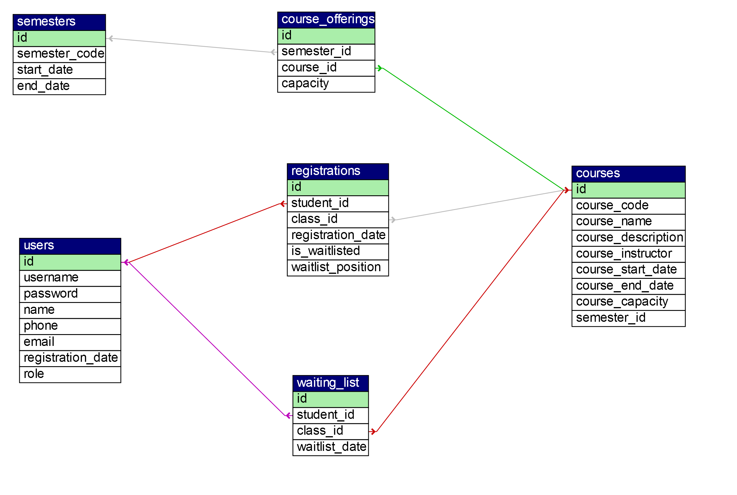
MySQL Database and Class Registration
Table | Description | Foreign Keys
users | Stores user information such as ID, username, password, name, phone, email, registration date, and role. | None
courses | Stores course information such as ID, course code, course name, description, instructor, start date, end date, capacity, and semester ID. | semester_id references semesters(id)
semesters | Stores semester information such as ID, semester code, start date, and end date. | None
course_offerings | Stores information about the course offerings for each semester. | semester_id references semesters(id), course_id references courses(id)
registrations | Stores information about the student registrations for courses. | student_id references users(id), class_id references courses(id)
waiting_list | Stores information about the students on the waiting list for courses. | student_id references users(id), class_id references courses(id)
Notes:
This database schema enables the registration portal to manage user accounts, courses, semesters, registrations, and waiting lists.
The database includes sample data for the courses, course_offerings, registrations, semesters, users, and waiting_list tables.
The tables are designed to store specific information related to each entity and establish relationships between.
For example, the courses table is linked to the semesters table using the semester_id foreign key. Similarly, the registrations and waiting_list tables are associated with the users and courses tables using foreign keys.

Slide 6
PHP Code for Registration Portal

Slide 7
index.php (Landing Page)
The landing page provides an introduction and overview of the platform.
It includes a header section that includes a common header file.
The main content is divided into sections for clarity and organization.
The "About Our Platform" section explains the purpose and features of the platform.
It emphasizes easy access to course information, academic resources, and simplified course registration.
The user-friendly interface allows for viewing course descriptions and managing the course schedule.
A "Get Started" button is provided to encourage user engagement.
The code includes PHP logic to check if the user is logged in and redirects to the login page if not.
The "Available Classes" section retrieves and displays a limited number of available courses from the database.
If no courses are available, a message is displayed.
The footer section is included using a common footer file.
Notes:
This PHP code represents a landing page for an online learning platform.
It includes a header section with a common header file for consistent branding.
The "About Our Platform" section provides an overview of the platform's purpose and features.
It emphasizes easy access to course information, academic resources, and simplified course registration.
The "Available Classes" section displays a list of available courses from the database.
The code checks if the user is logged in and redirects to the login page if not.
The page concludes with a footer section using a common footer file.
Overall, the landing page introduces the platform, highlights its features, and showcases available courses to engage users.

Slide 8
login.php
Includes PHP code for processing the login form submission and performing user authentication.
The code checks if the user ID exists in the database and verifies the password using the password_verify function.
If the login credentials are valid, the user's ID and username are stored in session variables, and the user is redirected to the index page.
If the credentials are invalid an appropriate error message is displayed.
The page also includes HTML code for the login form, consisting of user ID and password fields.
The form is submitted using the POST method to ensure security.
A "New User?" link is provided for users to register if they don't have an account.
The header and footer sections are included using common header and footer files.
Notes:
This PHP code implements a login page for user authentication.
The code retrieves the user ID and password from the login form and checks their validity against the database.
If the login is successful, the user's session is established, and they are redirected to the index page.
In case of invalid credentials, appropriate error messages are displayed.
The login form follows best practices for data submission using the POST method.
The page design includes a header and footer for consistent branding.
The option to register as a new user is provided for those who don't have an account.

Slide 9
portal.php (1 of 2)
The header section includes the "header.php" file, which is required once.
Inside the header, there is a jumbotron element with a centered heading displaying "Registration Portal".
The page contains a navigation section with tabs for different functionalities.
There are tabs for "List of Courses by Semester", "Enrolled Courses", "Add Courses", and "Delete Courses".
The footer is included using the "footer.php" file.
Notes:
The PHP code provided represents a registration portal that allows users to interact with different tabs for managing their courses.
The portal has a consistent header and title, providing a cohesive design throughout the pages.
The main content of the portal is divided into tabs using the Bootstrap framework, allowing users to switch between different functions easily.
Each tab has its own specific purpose and displays relevant information or forms for user interaction.
JavaScript functions are used to fetch data from the server asynchronously, providing a seamless user experience without page reloads.
The code also includes database operations, such as querying the database to retrieve information about semesters, registered courses, available courses, and course descriptions.
This code demonstrates the integration of HTML, PHP, JavaScript, and database operations to create a functional and user-friendly registration portal for course management.

Slide 10
portal.php (2 of 2)
The tabs section is organized using Bootstrap's tab-pane class and role attributes.
Each tab-pane represents a different section of content.
The "List of Courses by Semester" tab displays a dropdown to select a semester, and it dynamically fetches and displays courses based on the selected semester using AJAX.
The "Enrolled Courses" tab retrieves and displays the list of courses in which the student is enrolled.
The "Add Courses" tab provides a form to add new courses, including options for selecting a course and displaying its description.
The "Delete Courses" tab allows the student to select and delete courses from their registration.
Notes:
The tabs section of the PHP code focuses on implementing different tabs within the registration portal for managing courses.
The "List of Courses by Semester" tab provides users with the ability to view courses offered in different semesters. They can select a semester from a dropdown menu, and the system retrieves and displays the corresponding courses using AJAX.
The "Enrolled Courses" tab displays the courses in which the user is currently enrolled. The system retrieves the user's ID from the session and fetches the enrolled courses from the database, presenting them in a user-friendly list format.
The "Add Courses" tab allows users to add courses to their enrollment. The form includes fields for the student ID (prefilled based on the session information), course selection, and course description. The course description is dynamically updated using a JavaScript function based on the selected course.
The "Delete Courses" tab enables users to remove courses from their enrollment. The system retrieves the user's ID from the session and fetches the registered courses from the database, presenting them in a dropdown menu. Upon selecting a course and submitting the form, the selected course is deleted from the user's enrollment.
These tabs provide essential functionalities for users to manage their course enrollment, facilitating a streamlined and user-friendly experience within the registration portal.

Slide 11
courses.php
This PHP code displays a list of available courses on a web page.
It includes HTML and PHP code to fetch and display course information from a database.
The code starts with the header section, including a title and a jumbotron with a heading and a button that navigates to the portal.php page.
The database connection is established using the config.php file.
A SQL query is executed to retrieve the courses and their associated semesters from the database.
The courses are ordered based on the semester code using a CASE statement.
The code then iterates over the result set and displays the courses grouped by semester.
The semester heading is displayed if it's different from the previous course.
Each course is displayed in a card format, showing details like course name, code, instructor, start date, end date, capacity, and description.
The footer section is included using the footer.php file.
Notes:
This PHP code generates a web page displaying available courses.
It retrieves course information from a database and presents it in a visually appealing format.
The header section provides the title and a jumbotron with a heading and a button for user interaction.
The code establishes a database connection and executes a query to retrieve course data and their associated semesters.
It then iterates over the result set and displays the courses grouped by semester.
Each course is presented in a card format, showcasing essential details like the course name, code, instructor, start and end dates, capacity, and description.
The footer section is added to complete the page layout and provide a consistent user experience.
This code enhances the user interface and facilitates easy browsing and selection of available courses.

Slide 12

References
Bootstrap. (n.d.). Documentation. Retrieved from https://getbootstrap.com/docs
Dvorski, D. D. (2007). Installing, configuring, and developing with Xampp. Skills Canada.
IEEE Computer Society. (1998). IEEE Standard for Software Requirements Specifications (IEEE Std 830-1998). IEEE Computer Society. Retrieved from https://ieeexplore.ieee.org/document/720574
Martin, R. C. (2008). Clean code: A handbook of agile software craftsmanship. Prentice Hall.
Tsui, F., Karam, O., & Bernal, B. (2018). Essentials of software engineering (4th ed.). Jones & Bartlett Learning.
Wiegers, K. E., & Beatty, J. (2013). Software requirements (3rd ed.). Microsoft Press.
W3Schools. (n.d.). Learn HTML, CSS, JavaScript, PHP, SQL, and more. Retrieved from https://www.w3schools.com/

